Slide 1
Time Recovery Part-5
(GUI and Test)
報告人:郭孟儒

Slide 2
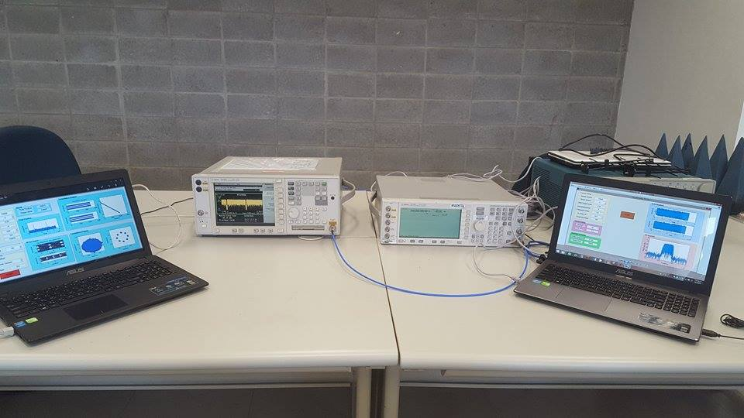
場景圖

Slide 3
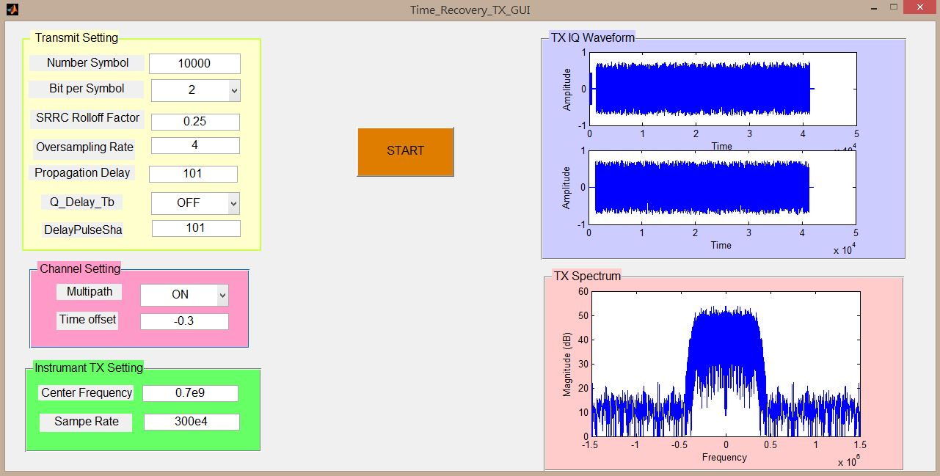
QPSK-TX

Slide 4
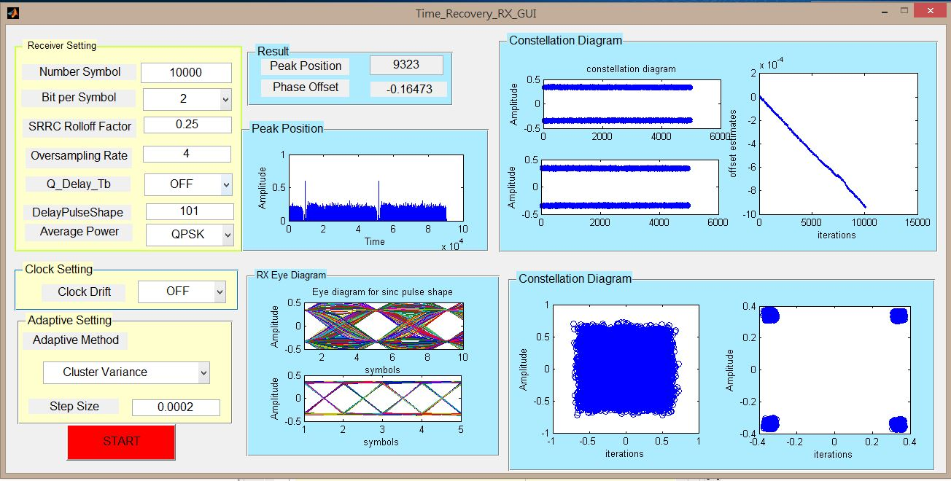
QPSK-RX-Cluster Variance

Slide 5
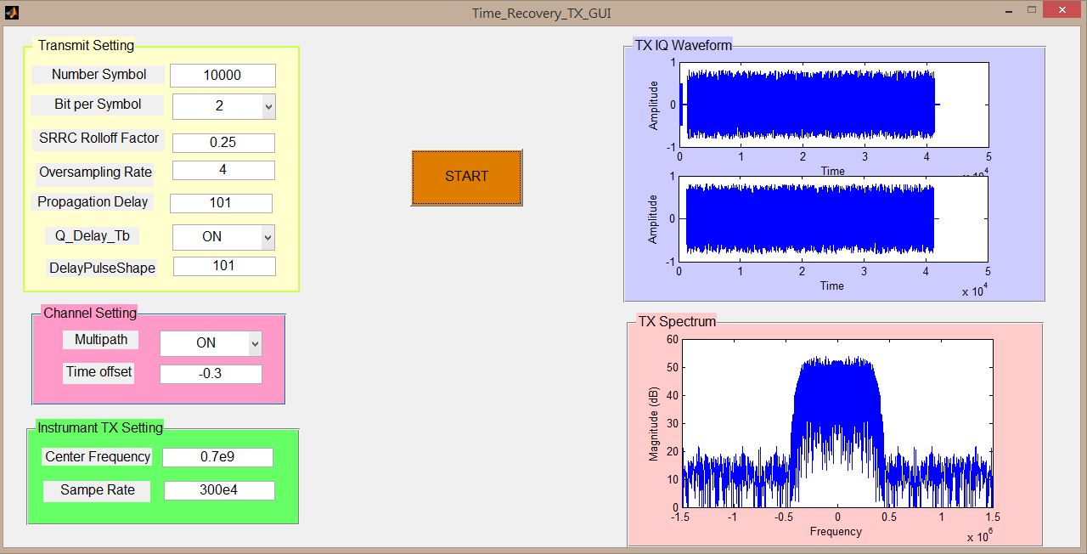
OQPSK-TX

Slide 6
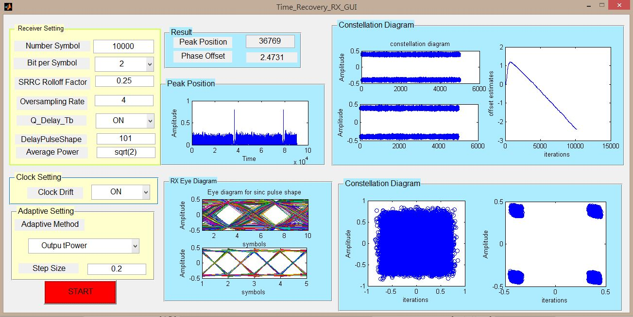
OQPSK-RX-Output Power

Slide 7
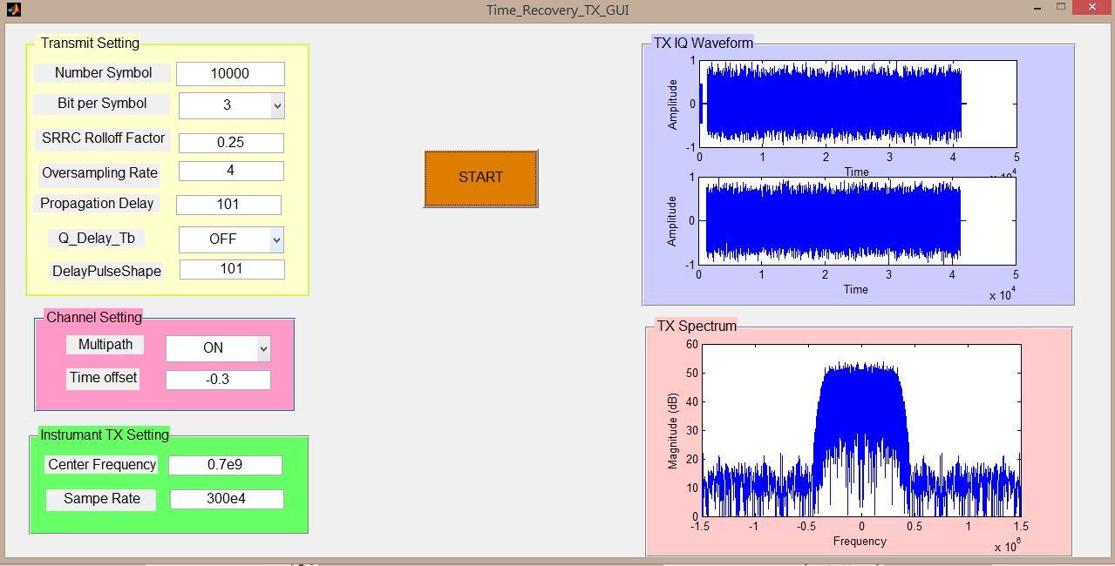
8PSK-TX

Slide 8
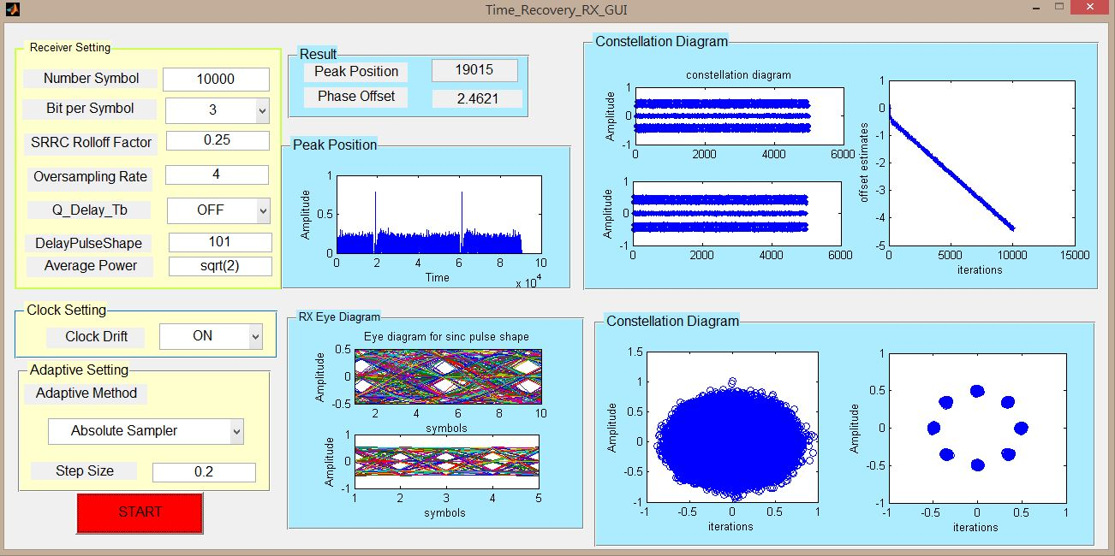
8PSK-RX-Absolute Sampler

Slide 9
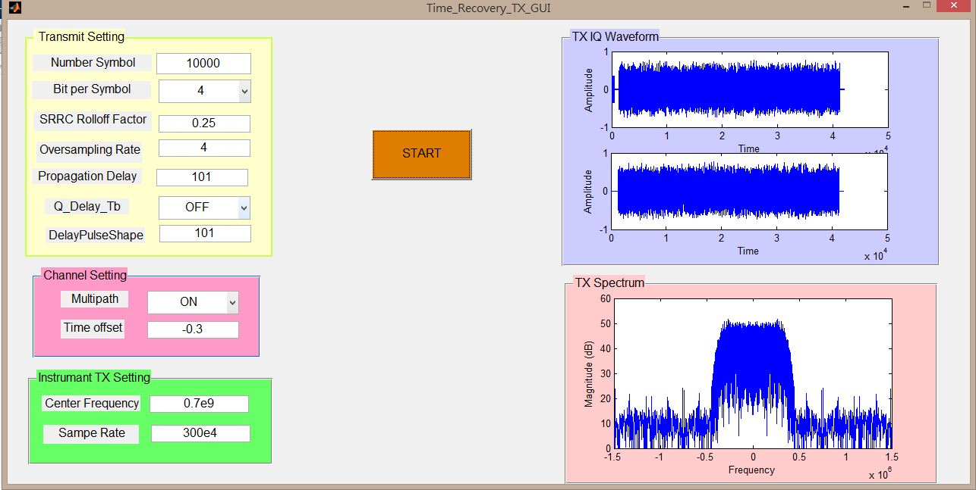
16QAM-TX

Slide 10
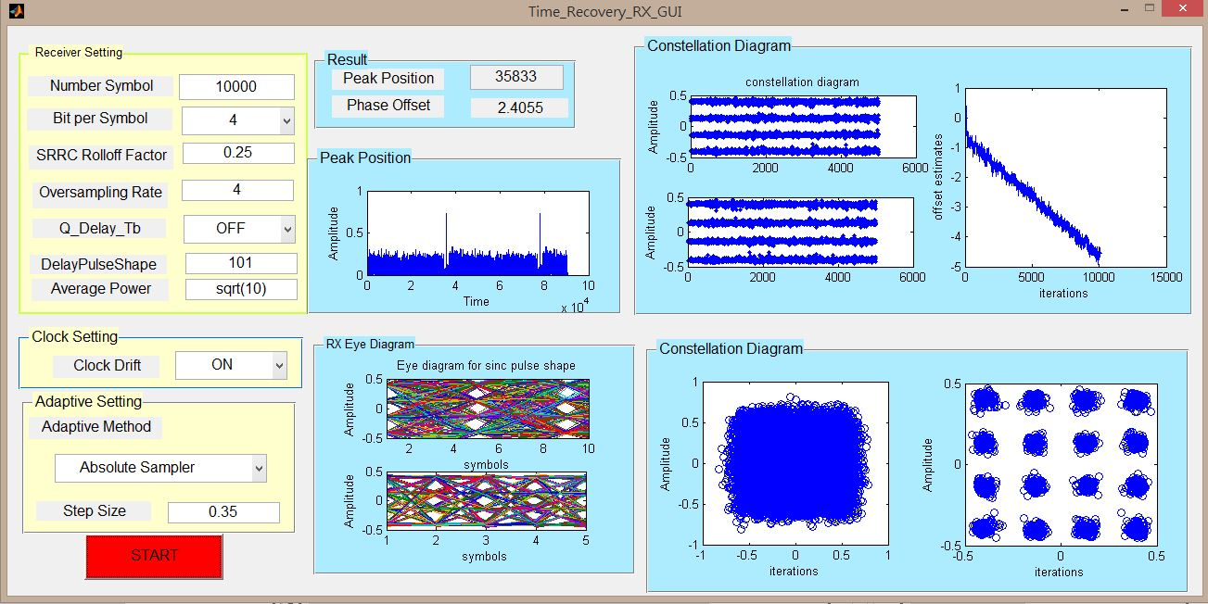
16QAM-RX-Absolute Sampler

Slide 11

64QAM-TX

Slide 12
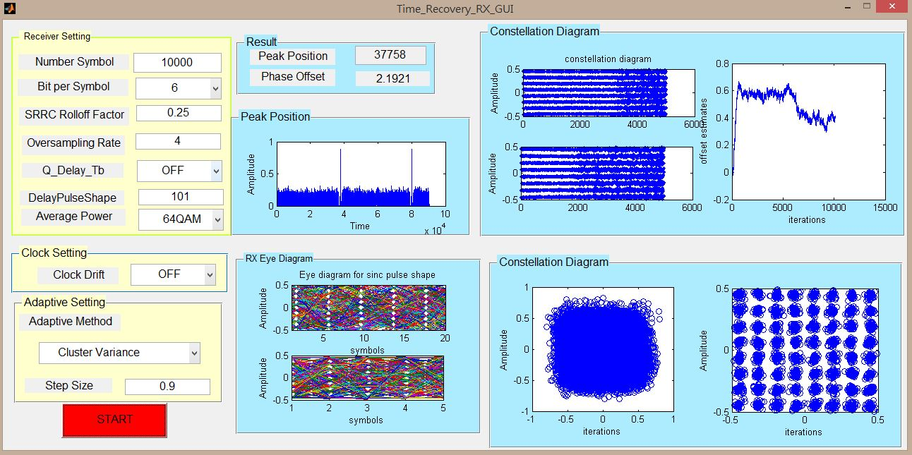
64QAM-RX-Cluster Variance

Slide 13


